Slide 1
TECHTROOPS
ASSIGNED TASKS SERVICENOW DEVELOPER VINAY TANNERU

Slide 2
User Administration:
Create 10 User account with different user names and Id's fill the complete form and observe all the fields in user table
Create 2 groups ( servicenow support, salesforce support)
Add 5 users in 1st group, add 5 users in the 2nd group
Check the functionality of roles, Administration, ITIL, itil_admin,ESS by giving to different users
Check the locked out and active checkbox functionality
Check the impersonate functionality
Check the possibility to add roles to users and groups check the behaviour
Check how to add user to group from user record, how to add user to group from group.
Create 2 Roles named as ( brillio_problem, brillio_change) for brillio_problem assign problem application, For brillio_change assign change application give this roles to different users and test the access.
create 1 role names as brillio_IPC give incident,problem,change application access by using contain roles option.
Create one new company,department,location from the respective tables and add to users.
check the functionality of the delegate user
Check the functionality of the Override application menu roles checkbox in the module.
Create a role named as prb_createnew that should give access only to the create new module in the problem application, other module access should not come with this role.
Create one elevated role named as brillio_elevate that should give access to system security applications only whenever the user is elevated.
Create one role named IPC_open that should provide access to all incidents, problems, and change applications Open module only.
Create a role named as brillio_resolved that should give access to resolved incidents only to the users and should be an elevated role.
create 1 role names as brillio_IPC give incident,problem,change application access by using contain roles option. for this requirement make this role as elevated and check whether elevated functionality works or not.
Create a role named as brillio_selfservice that should restrict self service application.
Check the functionality of impersonator role
Check the functionality of timezone and Date format fields in the user table.
Create 10 Users
Create 2 groups ( ericson_internal, ericson_External)
Create 2 Roles named as ( ericson, ericson_elevate) for techtroop assign incident application, For ericson_elevate assign problem application access with elevate checkbox true.
- give Ericsonrole to 1 st group, eicson_elevate to 2nd group, check how it will work by login to the different groups.

Slide 3
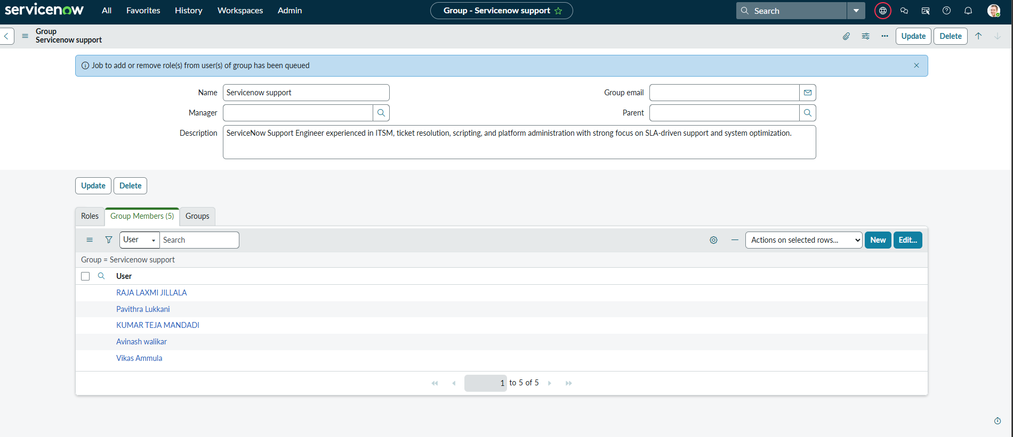
OUTPUT: GROUP1

Slide 4
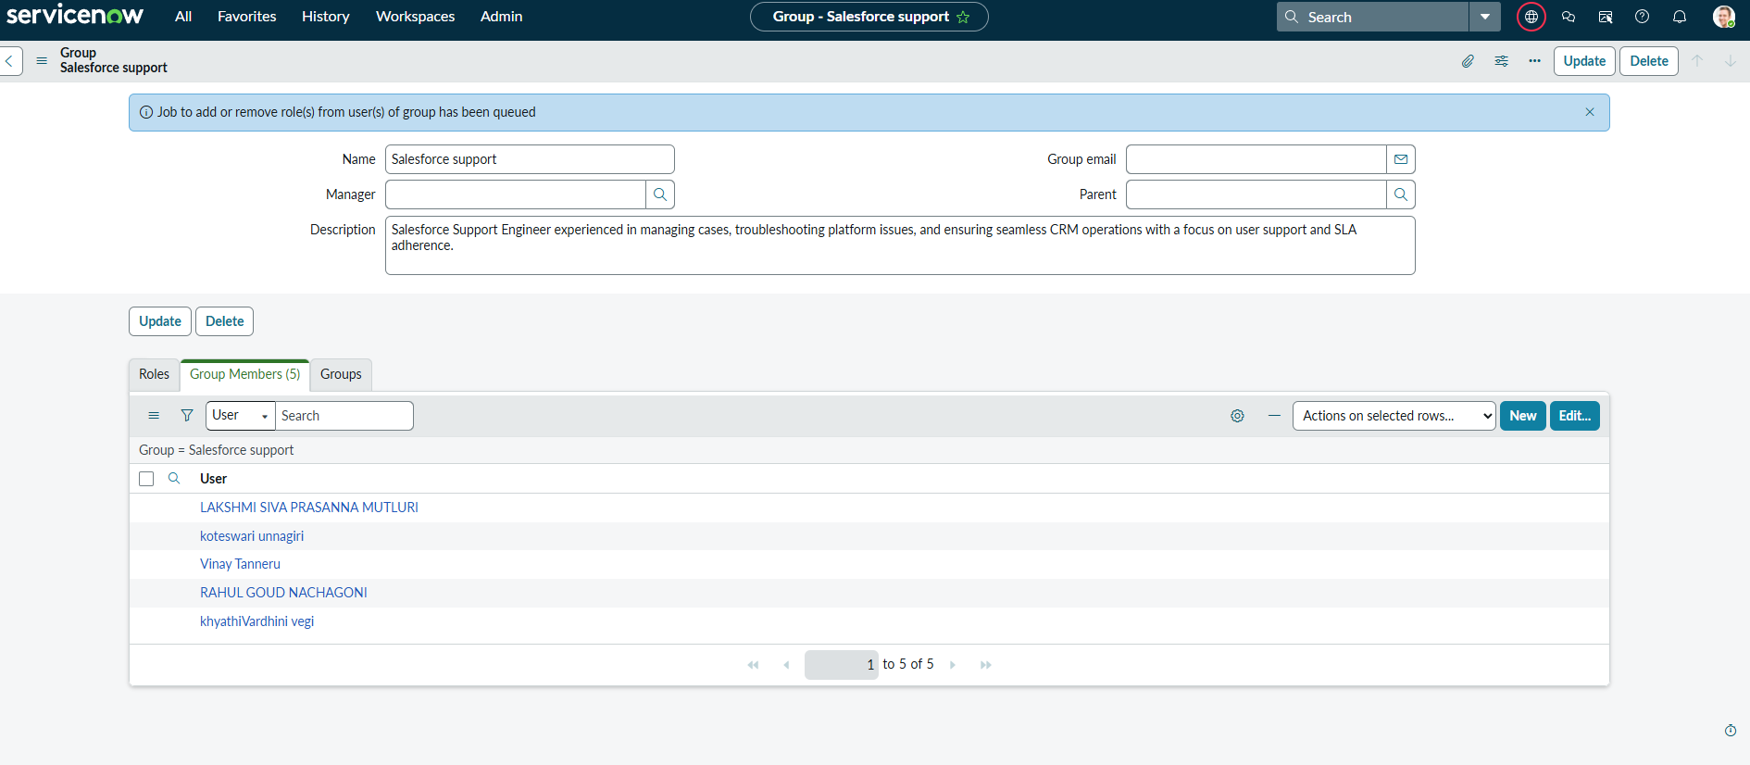
OUTPUT GROUP2:

Slide 5
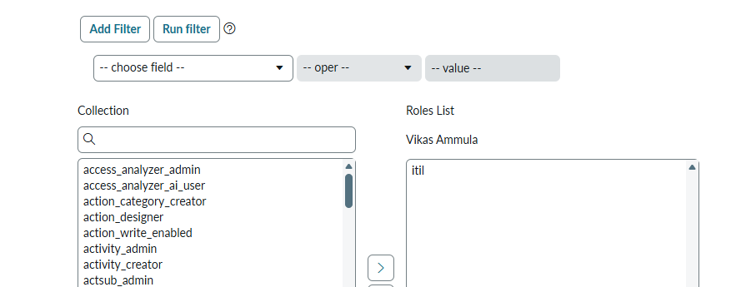
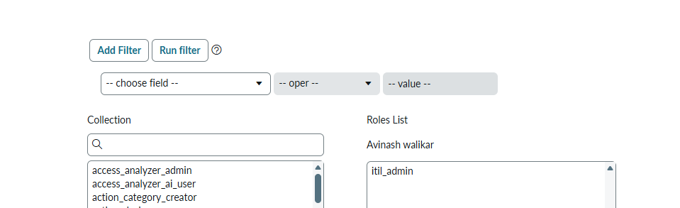
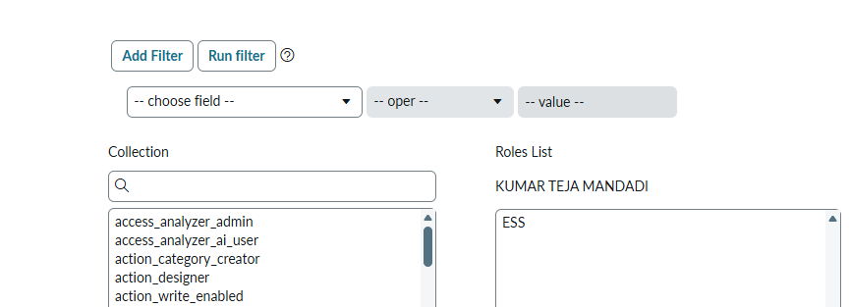
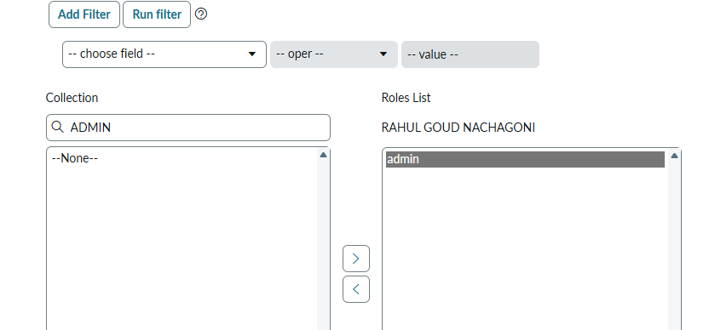
FUNCTIONALITY OF ROLES BY DIFFERENT USERS

Slide 6
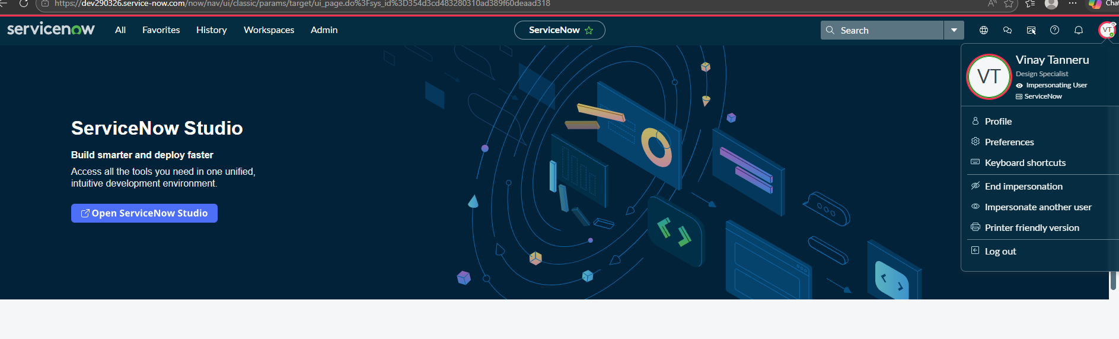
Checked the locked out and active checkbox functionality to the users Rahul and kumar can’t impersonate due to locked out checked impersonate functionality vinay user worked

Slide 7
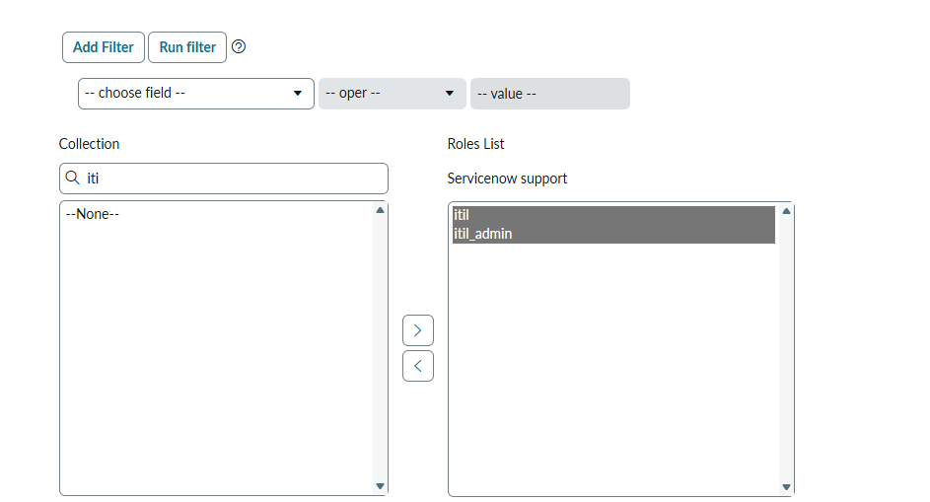
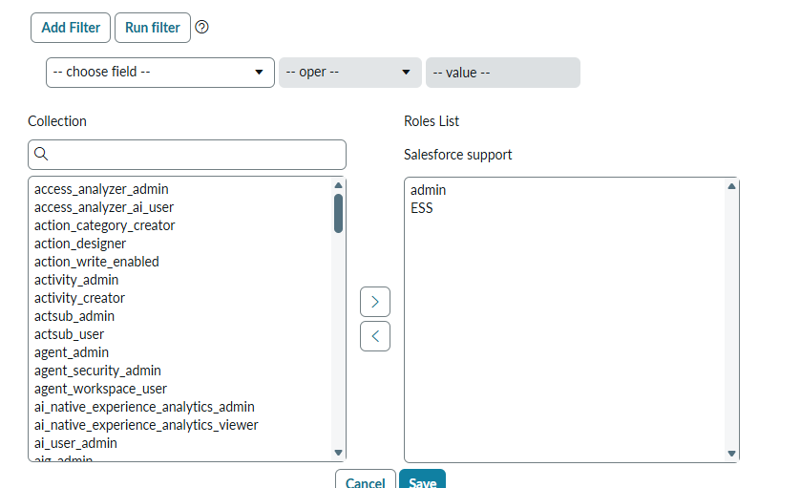
GROUPS WITH THE ROLES

Slide 8
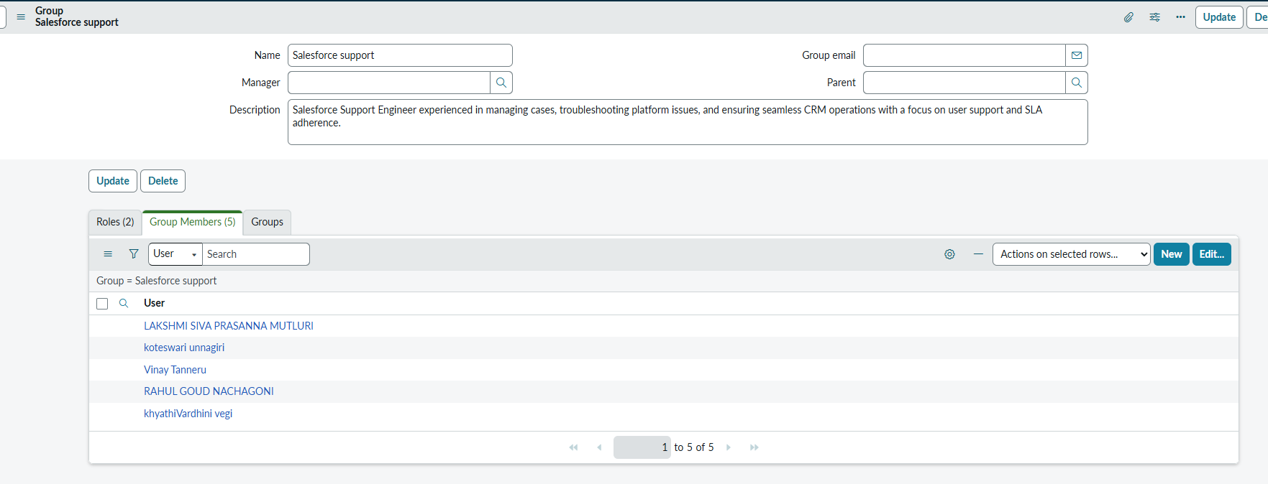
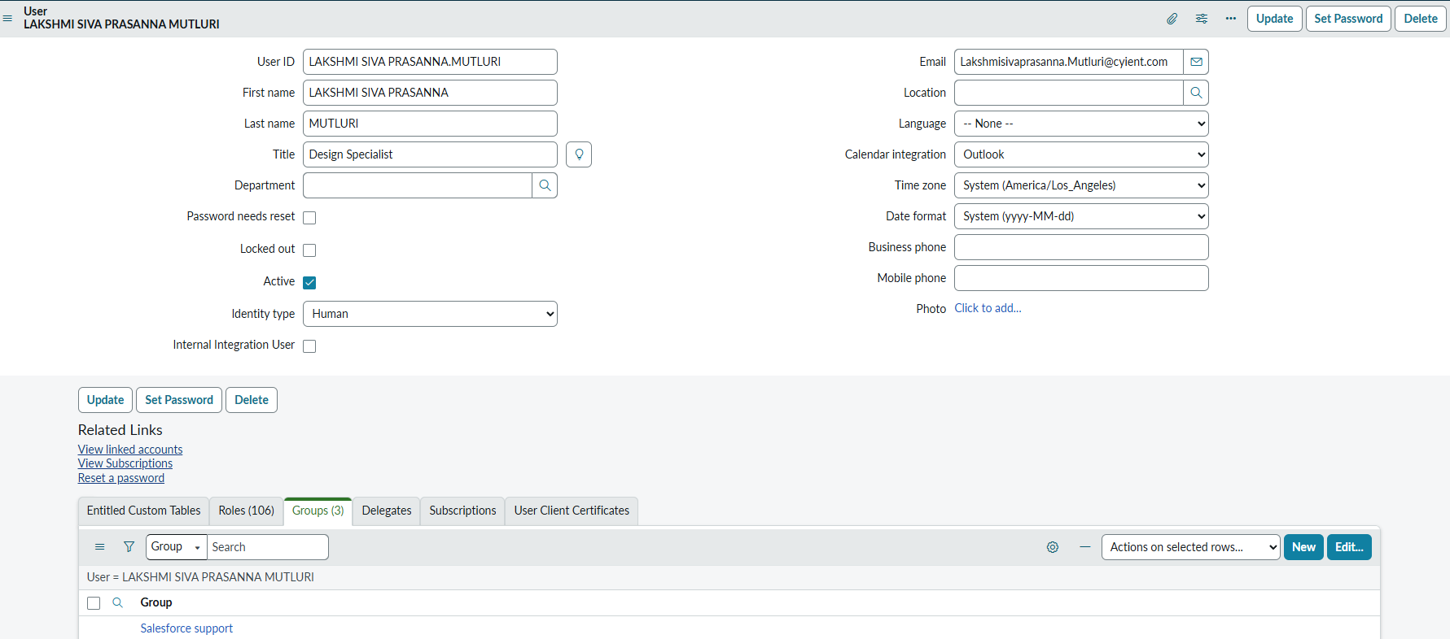
Add User to Group from User Record and user to group form group record

Slide 9
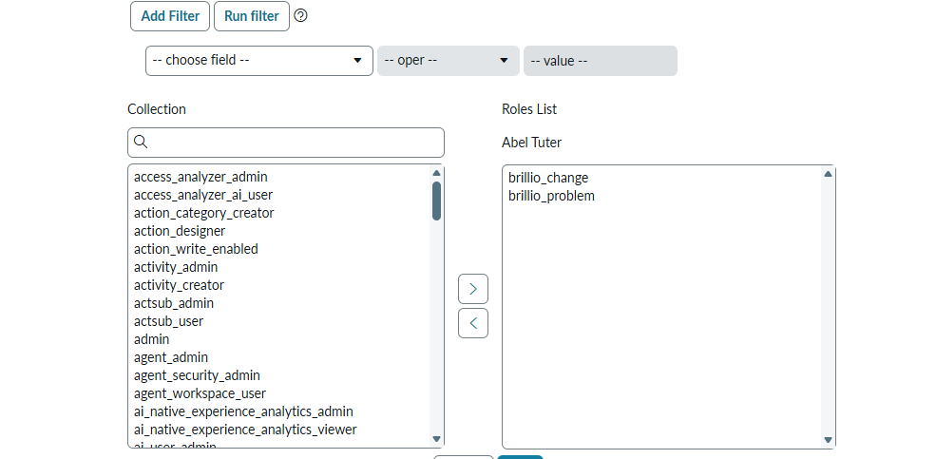
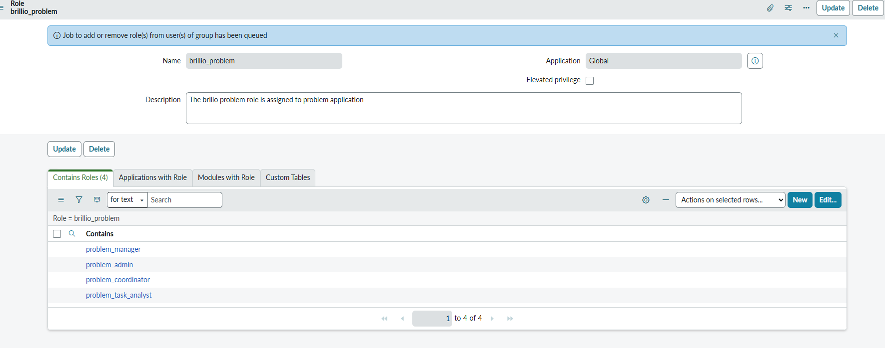
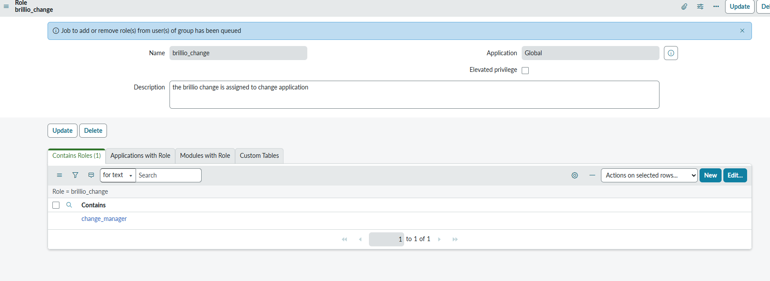
BRILLIO ROLE USED TO OPEN PROBLEM AND CHANGE CHECKED BY USER

Slide 10
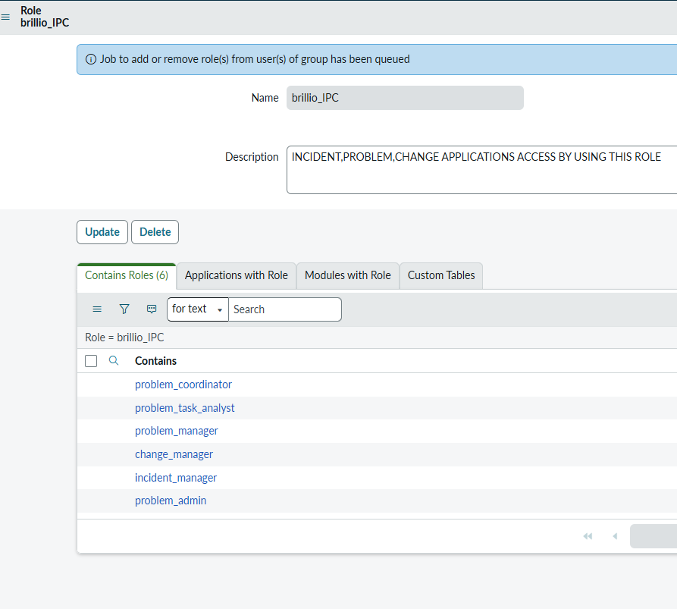
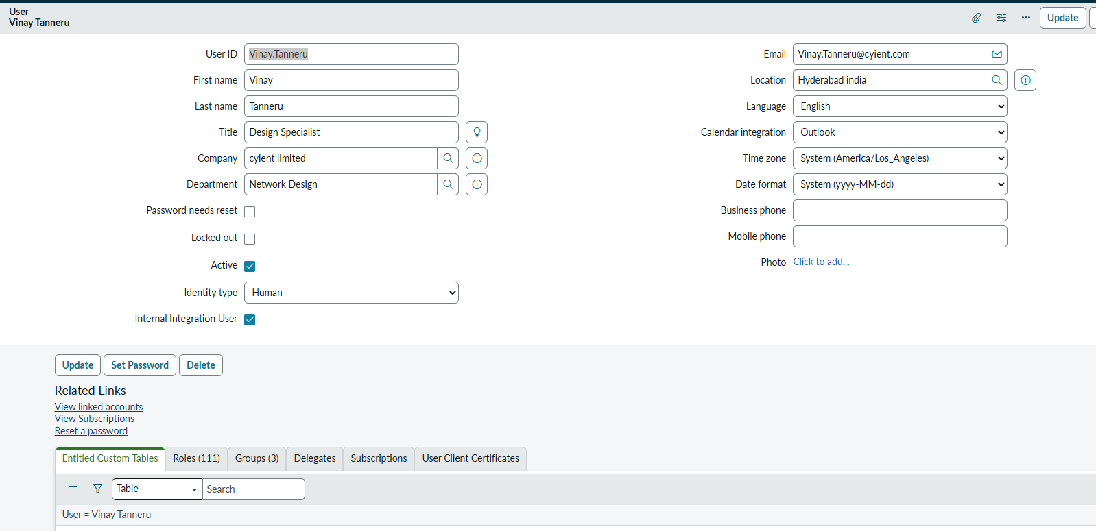
create 1 role names as brillio_IPC give incident,problem,change application access by using contain roles option. Create one new company,department,location from the respective tables and add to users

Slide 11
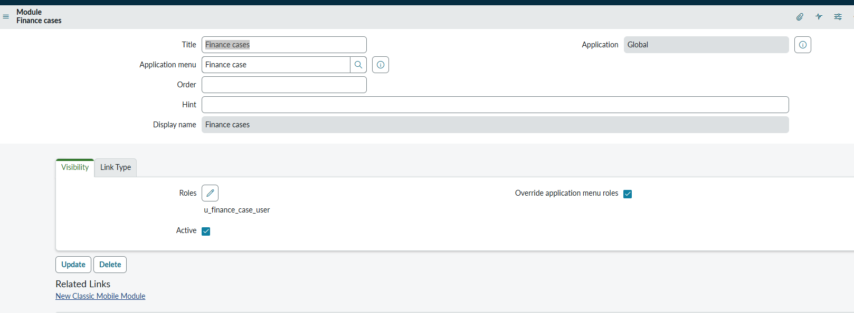
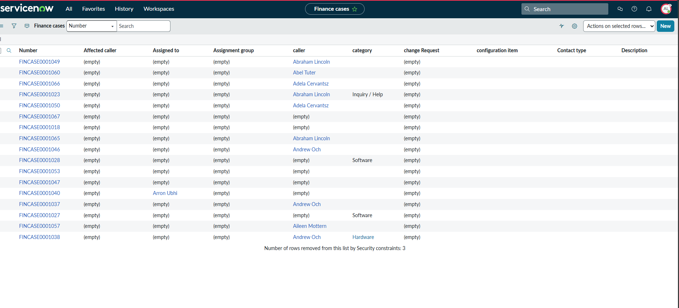
Check the functionality of the Override application menu roles checkbox in the module. User can see only the financecase module parent and not the child finance cases

Slide 12
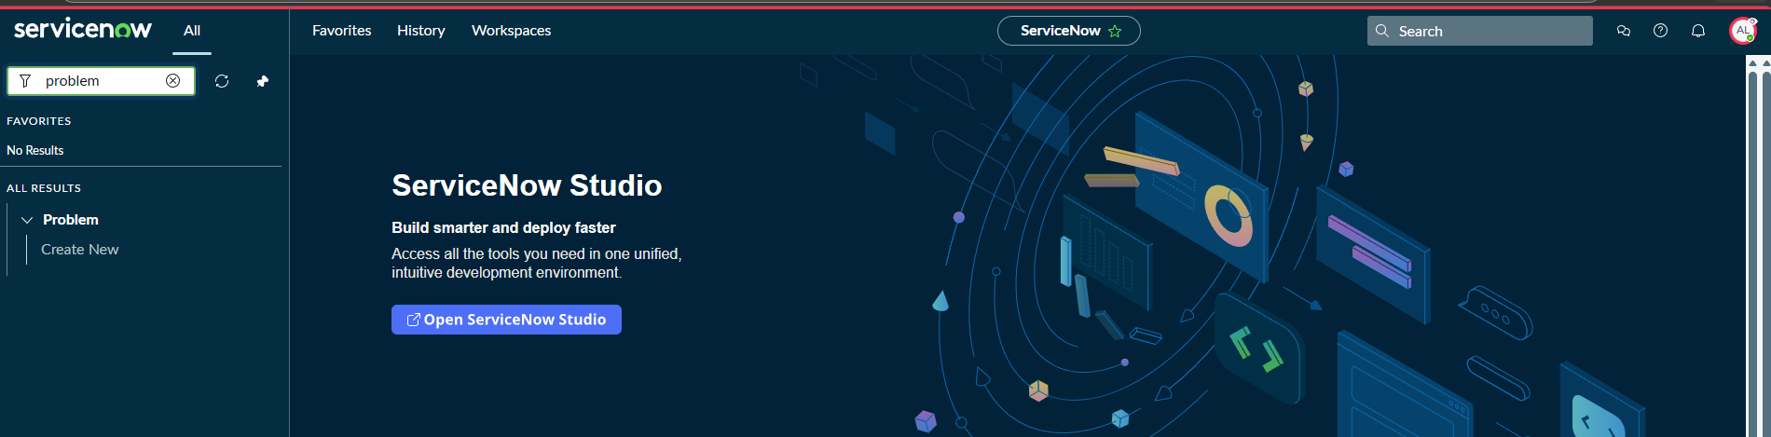
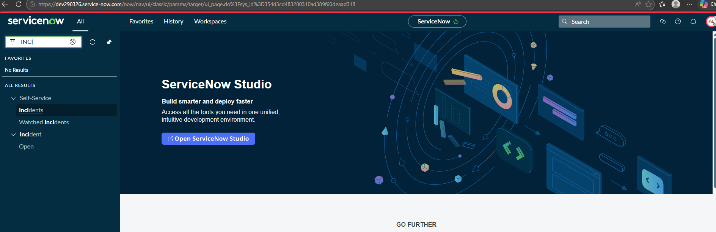
Create a role named as prb_createnew that should give access only to the create new module in the problem application, other module access should not come with this role
Create one role named IPC_open that should provide access to all incidents, problems, and change applications Open module only.

